Slide 1

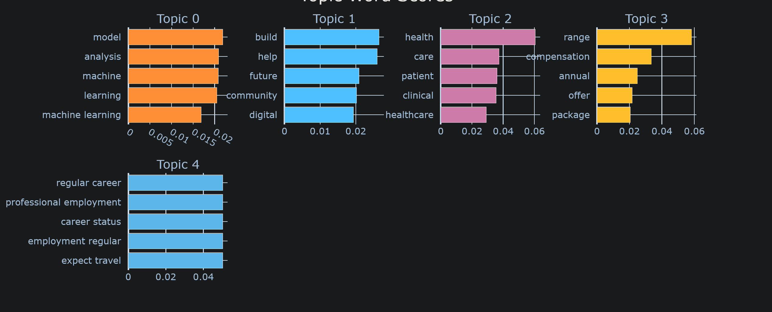
Bertopic Job Postings Analysis
Denley Tran
Advisor: Prof. Pang, Prof. Wang, Ph.D.
School of Computing and Data Science
Wentworth Institute of Technology
Abstract
Datasets
Results
Discussion
We used a dataset of computer science job listings scraped from multiple job boards on Kaggle. To prepare the data for analysis, we performed the following cleaning and preprocessing steps:
Separated salary ranges into lower and upper values to allow numeric comparison and visualization
Removed job postings without descriptions because topic modeling requires full text to extract keywords
Replaced all empty fields with “N/A” to prevent missing-value errors during preprocessing
Split location into “city” and “state” to support geographic analysis
Removed duplicate job descriptions to avoid overweighting repeated postings in the topic model
Some issues we ran into while working on this project include:
Data Cleaning: Some insufficiently cleaned data led to the topic clusters having irrelevant keywords within them.
Data Collection: Had to resort to using Kaggle for historical job postings since it was impossible to scrape job postings from past years.
This project, the Bertopic Job Postings Analysis Project, investigates the key characteristics, roles, and qualifications associated with high-paying computer science jobs by analyzing thousands of job descriptions scraped from major job boards like Glassdoor.
Topic [0] Machine Learning: Keywords strongly center on AI and machine learning.
Topic [1] Community Building: Keywords are focused on the concept of community.
Topic [2] health: Most of the keywords are related to employee healthcare.
Topic [3] Employee Benefits: Keywords indicate a discussion of compensation and benefits.
Topic [4] Employment Status: Keywords relate to employment type and status (e.g., job title/role).
Conclusions
We were able to create a pipeline that is capable of determining the common characteristics between all high-paying computer science jobs across the website “Glassdoor.”
Introduction
This project investigates what makes a job listing high-paying across major job boards (e.g., Glassdoor, Indeed). Using thousands of job descriptions and the BERTopic machine-learning model, we extract recurring topics and keywords that consistently appear in high-salary roles.
By identifying the skills, responsibilities, and industry terms most associated with high compensation, this analysis helps job seekers understand what employers value and highlights the kinds of roles and qualifications linked to higher earnings.
Acknowledgements
Methodology
Professors Pang and Wang: Supervisors of the project
The dataset of 627 unique job postings was obtained from Kaggle.com. Data preprocessing included cleaning and formatting the data in a way that the topics wouldn’t become too unclear. Analysis was conducted in Python using Pandas for cleaning and Matplotlib for visualization. The workflow followed four stages: raw data acquisition → preprocessing → analytical exploration → results interpretation.
Bibliography
Khodeir, Nabila, and Fatma Elghannam. "Efficient topic identification for urgent MOOC Forum posts using BERTopic and traditional topic modeling techniques." Education and Information Technologies 30.5 (2025): 5501-5527.
Hill, Alessandro, Kalen Goo, and Puneet Agarwal. "Recommending the right academic programs: an interest mining approach using BERTopic." Data Mining and Knowledge Discovery 39.3 (2025): 1-40.

